Slide 1
Cost-based labeling of groups of mass spectra
SIGMOD Conference 2004

Slide 2
Overview
Introduction
Problem formulation
Proposed Algorithms
Theoretical cost analysis
Experimental results and discussion
Comments

Slide 3
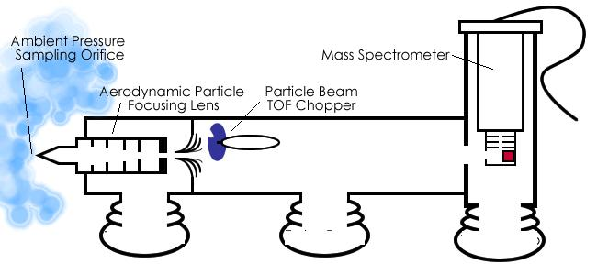
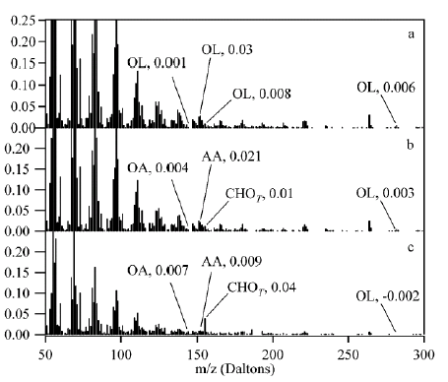
Introduction
Working of Aerosol Time of Flight Mass Spectrometer

Slide 4
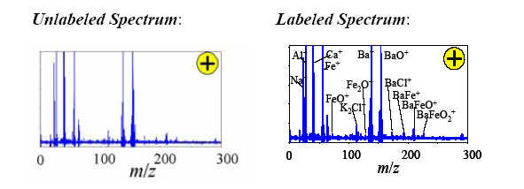
Mass Spectrum Labeling
A time series of observations, one per collected particle, where
each observation is a set of labels (ion-quantity pair)
A time series of transactions, each recording the items purchased by a customer while visiting the store.

Slide 5
Problem Formulation
A mass spectrum can be represented as a normalized vector b, where Σ_{i} b_{i} = 1 and b_{i} is the relative signal intensity at m/z value i.
The signature of an ion is a vector s, such that Σ_{i} s_{i} = 1, representing the distribution of its isotopes, i.e., s_{i} is the relative abundance of isotopes with m/z value i.
A signature library is a set of signatures S = { s₁, s₂, ..., s_{n}} where s_{j} is the signature of chemical ion j.
If we arrange the n signatures in the signature library in order, the signature library can be represented as a matrix A = [s₁, s₂, ..., s_{n}], where the k^{th} column in matrix A presents signature k. The labeling task consists of finding an n-dimensional vector x such that x[j] is the relative abundance of chemical ion j.
Ax =b, x ≥ 0
To account for noise, measurement errors and calibration discrepancies define a distance function D and error bound E, then the solution space of spectrum b is
L_{b} = {a | D(Aa,b) < E and a ≥ 0}
The solution can be found using the LP model
min Σ_{i} s_{i} s.t (Aa - b)≤ s and (Aa - b)≤ -s ωηερε α≥0,σ ≥0

Slide 6
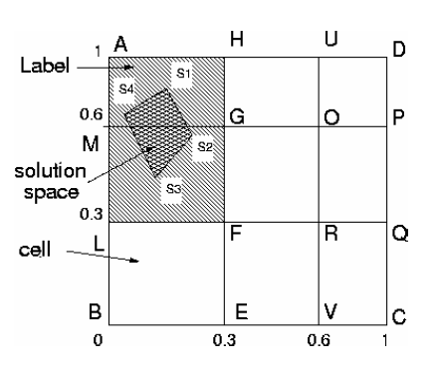
Solution to the Problem
The LP model has infinite number of solutions
We care about solutions which are significantly different
How to deal with continuous infinite space??
DISCRETIZATION
A threshold vector T = { t₁, t₂, ..., t_{d}} divides each dimension of the search space into d ranges and the index vector I = { <l₁, h₁>, <l_{2 ,}h₂>, ...,<l_{n ,}h_{n}>}
The of SINGLE spectrum labeling reduces to subspace searching
(Zheng Huang et al)

Slide 7
Group Spectrum labeling
A group of spectra that is collected at a single location over a short time-span is likely be similar.
Given a group of spectra {b_{i}} we can find a label set {L_{i}} which consist of labels of the form {x_{i}} each of length n
Define support(x) = |{L_{i} | x_{i} Є L_{i} }|/| L_{i} |
Group label : Given a group of spectra B = {b_{i}} and a threshold Min Sup, x is a group label if the support of x w.r.t. B is greater than Min Sup.
HOW TO SOLVE THIS???
MINING FREQUENT PATTERNS

Slide 8
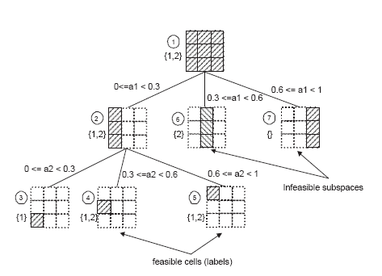
Method1: DFS Voting Algorithm
DFSVoting(subspace S,set of spectra C)
Depth First Search(subspace S)
if (¬is feasible(S))
RETURN
else
if (S is a cell) // cell corresponds to the finest granularity
output the corresponding label of S
else
pick dimension(j)
split S into a set of subspaces {Si} s.t. each Si is not divisible on dimension j
for each result subspace Si
Depth First Search(Si)
end for
C = {b|b Є C, S is feasible w.r.t. b}
|C’|< Min_Sup*w
DFSVoting( Si,C’)

Slide 9
Method 2: Candidate Generation and Test
GenTest
L = {} B0 = {(1 − Min Sup) * w + 1 spectra randomly chosen from B}
for each b in B0
Find Fi, the label set of b
L = L U Fi
for each label l in Fi
l.count++
for each spectrum b in B − B0
for each l in L
if l is a label for the b
l.count++;
for each label l in L
if (l.count > Min Sup * w)
output l as a solution group label

Slide 10
Cost Analysis
Estimate the effect of various inputs on the overall cost of the algorithm
Study the characteristics of the data / input w.r.t to the algorithm
Notations:
CSingle Cost of labeling a single spectrum
CSingle = d*(n-1)*m
CVoting Cost of DFSVoting algorithm
CGenTest Cost of GenTest algorithm
CGenTest = CSingle*(w − t + 1)+(t − 1) * m *((1 − s/w ) *(w − t + 1) + 1)
where t = w*Min_Sup

Slide 11
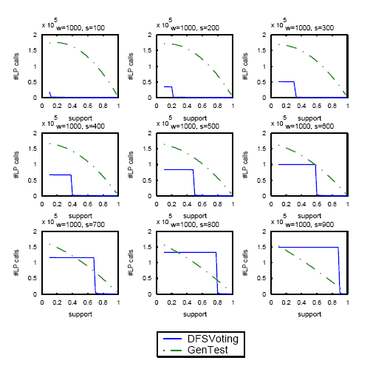
Algorithm profile
Algorithm choice depends on the choice of Min_Sup value
Algorithm choice also depends on s

Slide 12
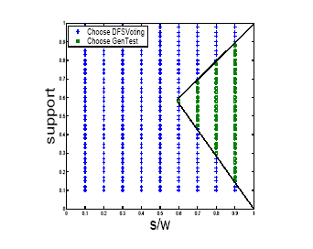
Decision Plot
The boundary between the two regions corresponds to the intersection points between the two methods in the algorithm profile

Slide 13
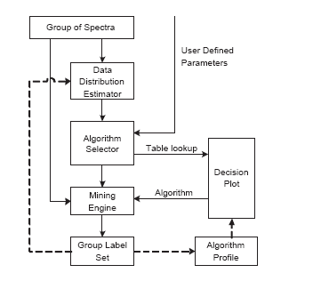
System Graph

Slide 14
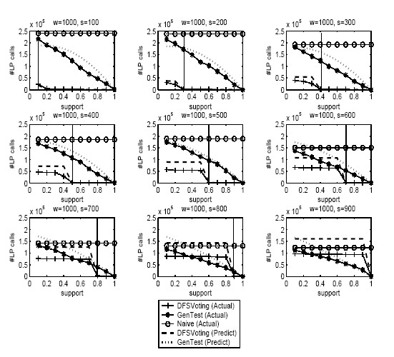
Results and Discussion
How close are the derived estimates based on cost metrics to experimental results?
How good is the cost estimation in terms of deriving the right decision plot?

Slide 15
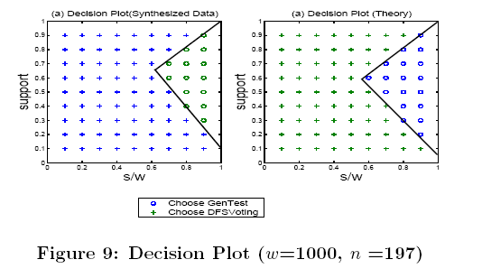
Results and Discussion
How good is the theoretically derived decision plot in making decisions regarding algorithm selection
The differences observed were found to be tolerable

Slide 16
Comments
Problem formulation in data mining framework
Evaluation of different algorithms
Algorithm profiling and cost based optimization
Analogy to market basket analysis

